Slide 1

Early Reading and Phonics at St Richard’s
Thursday 3rd October 2024

Slide 2
Curriculum Intent for Early Reading
At St Richard’s School we have adopted a robust and consistent approach to the teaching of early reading. We believe that it is a fundamental skill that will allow children to access all areas of the curriculum successfully, laying a firm foundation for the children’s futures. Our intent is that all children, regardless of their background and starting point, become fluent readers.
In EYFS and Key Stage 1 there is an emphasis on the teaching phonics. Our phonics is taught follow the DfE Letters and Sounds programme. Within daily phonic sessions, children have the opportunity to revisit previous learning, practise and apply new skills in structured but engaging ways. All reading books sent home are linked to the phase where the individual is working at.
We will deliver an early reading program that comprises of:
Informal teaching of Phase 1 phonics in Nursery as well as focused adult led sessions.
Direct, focused phonics which is taught every day in Reception and key stage 1
Phonics will be taught progressively from EYFS to Year 2 as an effective way of developing children’s reading and spelling skills. Sight-recognition of words will complement the teaching of phonics.
Children will read from books with the sounds they know, while they are learning to read.
A robust system for catch-up sessions delivered by skilled trained teaching assistants.
The community working together to instil in children a love of literature and reading for meaning and pleasure.

Slide 3
What is Phonics?
Identifying sounds in words
Matching sounds to letters or groups of letters
Learning how sounds are represented by letters
Ability to blend sounds into words for reading
Ability to segment words into sounds for spelling

Slide 4
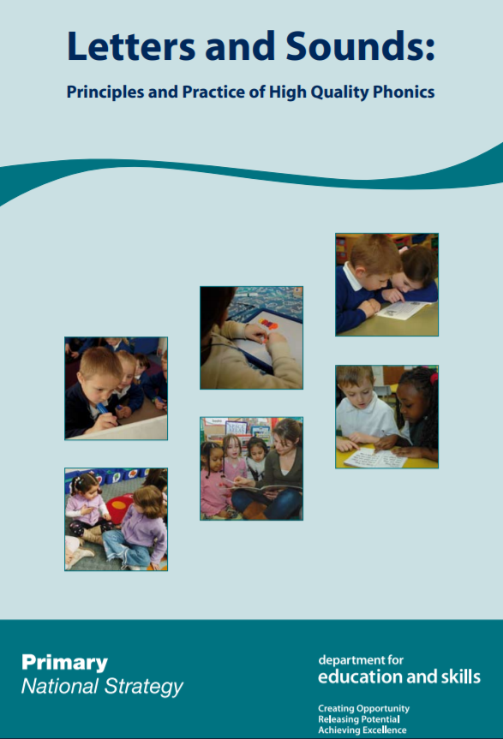

Letters and Sounds
Historically we have used Letters and Sounds published in 2007
From Spring 2022 schools needed to have a programme from a validated list of schemes.
St Richard's developed its own bespoke phonics programme based on Little Wandle.
There are 6 phases of phonics.
Starting in Nursery with phase 1
Phase 6 finishing in Year 2.

Slide 5
Definitions
A phoneme is the smallest unit of sound in a word
A grapheme is a letter or group of letters used to write one phoneme eg. d-o-g, sh-o-p, p-ar-k
A digraph is two letters which make one phoneme eg. ai, ee, or, th, sh
A trigraph is three letters which make one phoneme eg. igh, air
A split digraph is where two letters are not adjacent eg. a-e (game), e-e (these), o-e (rope), i-e (kite), u-e (June)
GPC is grapheme phoneme correspondence. Knowing a GPC means being able to match a phoneme (sound) to a grapheme (written representation) and vice versa.
Tricky words (also known as common exception words) are words that can’t be decoded using phonics eg. the

Slide 6
Short sounds
y
w
c
t
d
h
k
g
ch
b
p
j

Slide 7

Long Sounds
sh
l
f
s
th
n
ng
m
z
v
r

Slide 8
Blending
Recognising the phonemes in a written word and merging them in order to produce the word. This is an essential skill for reading.
cat shed park
take night enjoy

Slide 9
Segmenting
The opposite of blending
“Chopping up” the word into phonemes
An essential skill for spelling
t-r-ai-n
s-n-ow
s-t-r-ee-t
b-r-igh-t

Slide 10
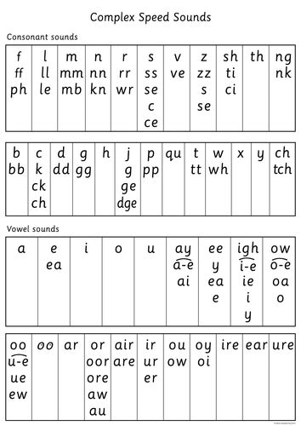
26 letters, 44 phonemes!

Slide 11
Phonics progression
Phase One: Builds phonological awareness & develops oral blending & segmenting skills
(Starts in Nursery and is ongoing)
Develops:
- children’s speaking and listening skills
- Focuses on getting children attuned to the sounds around them
- Developing oral blending and segmenting skills
Phase 1 is divided into seven aspects
Each aspect contains three strands:
-Tuning in to sounds (auditory discrimination),
- Listening and remembering sounds (auditory memory and sequencing
- Talking about sounds (developing vocabulary and language
comprehension).

Slide 12
Phase 1
Aspect 1 – General sound discrimination – environmental
Develops children’s awareness of the sounds around them and to develop their listening skills.
Ie listening walks, drumming on different items outside and comparing the sounds, playing sounds lotto and making musical instruments
Aspect 2 – General sound discrimination – instrumental sounds
Develops children’s awareness of sounds made by various instruments and noise makers.
Ie comparing and matching sound makers, playing instruments alongside a story and making loud and quiet sounds.
Aspect 3 – General sound discrimination – body percussion
The aim of this aspect is to develop children’s awareness of sounds and rhythms.
Ie singing songs and action rhymes, listening to music and developing a sounds vocabulary.

Slide 13
Phase 1
Aspect 4 – Rhythm and rhyme
Develops children’s appreciation and experiences of rhythm and rhyme in speech.
Ie rhyming stories, rhyming bingo, clapping out the syllables in words and odd one out.
Aspect 5 – Alliteration
Focuses on initial sounds of words
Ie I-Spy type games and matching objects which begin with the same sound.
Aspect 6 – Voice sounds
Focuses on distinguishing between different vocal sounds and to begin oral blending and segmenting.
Ie Metal Mike, Cross the river

Slide 14
Phase 1
Aspect 7 – Oral blending and segmenting
Develops oral blending and segmenting skills.
Ie Talking teddy, the teacher could say some sounds, such as /c/-/u/-/p/ and see whether the children can pick out a cup from a group of objects. For segmenting practise, the teacher could hold up an object such as a sock and ask the children which sounds they can hear in the word sock.

Slide 15
Phase 2
Phase Two: Introduction of phoneme grapheme correspondences
blending and segmenting, vc and cvc words.
(6 weeks Reception autumn term)
Set 1: s, a, t, i
Set 2: m, n, o, p
Set 3: b, c, g, h
Set 4: d, e, f, v
Set 5: k, l, r, u
Tricky words: I, the, to, no, a, go, into, was, have, of

Slide 16
Phase 3
Phase Three: Basic GPCs completed + tricky words more blending and segmenting (letter names)
(12 weeks Reception spring/summer term)
Set 1: j, w, z, x
Set 2: y, ff, ll, ss
Set 3: zz, phase 4 vcc, cvcc, ccvc, ccvcc
Set 4: ch, sh, th, ng
Set 5: qu, wh, ck, ai
Set 6: ai, ee, igh, oo (long)
Set 7: oo (short) ar, or, ur
Set 8: ow, oi, ear, air
Set 9: ure, er
Incorporates vcc, cvcc, ccvc, ccvcc words
be said he me you we says my she asks put do are your they so her all like some come were there little one out what

Slide 17
Phase 4
Phase Four: (taught alongside Phase 3)
When children start Phase 4 they will know a grapheme for each of the 42 phonemes.
They will be able to blend phonemes to read CVC (consonant-vowel-consonant) words, and segment in order to spell them.
Children will also have begun reading straightforward two-syllable words and simple captions, as well as reading and spelling some tricky words.
In Phase 4, no new graphemes are introduced. The main aim of this phase is to consolidate the children’s knowledge and to help them learn to read and spell words which have adjacent consonants, such as trap, string and milk.
(4-6 weeks - begin in Reception, consolidate on entry to year 1)

Slide 18
Phase 5
Phase Five: Broadening knowledge of GPCs, alternative pronunciations and spellings eg. eat/bread, find/milk (Year 1 throughout year)
Set 1: ir, ie, ue, ew
Set 2: a, e, i, o
Set 3: u, aw, ow, oe
Set 4: a-e, e-e, i-e, u-e
Set 5: ea, e-e, y (ee), ou (oa)
Set 6: y (igh), ie (ee), g (j), c (s)
Set 7: al (ar), ey (ee), ou (oo), a (ar)
Set 8: ch (c), ch (sh), au (or), ph (f)
Set 9: are (air), ear (air), ve, se (ze)
Set 10: le, se, ce, tch
Set 11: oor, ore, or/ur
Set 12: ear/ur, u/oo, adding s and es
asked very, Mr Mrs want where today friend love again, once school small called pull push full their our people water would could should looked who whole many any through thought two because don’t sure different eyes busy beautiful pretty hour move improve four eight laughed parents shoe fruit bought brought clothes climb gone done every everybody sugar rough

Slide 19
Alternatives spellings and pronunciations
Alternative Pronunciations of previously taught graphemes (reading) e.g.
ea – usually sounds like ‘sea’ but can sound like ‘head’
ow – down/snow
y - cry/baby/gym
g - get/giant
Alternative Spellings for previously taught phonemes e.g.
oa sound as in ‘coat’ - can be spelt as in ‘low’, ‘toe’, or ‘stone’
ai (rain) - play, game
air (hair) - care, pear, there
When learning alternatives, the emphasis is on ‘Try it both ways and make a decision on which on looks /sounds ‘right’.

Slide 20
Phase 6
Phase Six: Spelling alternatives +rarer GPCs, increasing fluency (Year 2 throughout year)
At the start of Phase 6 of Letters and Sounds, children will have already learnt the most frequently occurring grapheme–phoneme correspondences (GPCs) in the English language. They will be able to read many familiar words automatically.
When they come across unfamiliar words they will in many cases be able to decode them quickly and quietly using their well-developed sounding and blending skills. With more complex unfamiliar words they will often be able to decode them by sounding them out.
At this stage children should be able to spell words phonemically although not always correctly. In Phase 6 the main aim is for children to become more fluent readers and more accurate spellers.

Slide 21

Assessment
At the end of every half term the children are assessed on the sounds and tricky words they have been taught using Phonics Tracker.
We now have set up a bespoke assessment on Phonics Tracker that matches our phonics progression.
Phonics tracker then analyses the data so gaps can be identified and children receive phonics interventions based on the gaps.

Slide 22
How are the children at St Richard’s taught phonics?

Slide 23

Consistency is key!
All classes display a phonics frieze
Use matching mnemonics flashcards to teach GPCs
Introduce new GPCs with St Richard’s ditties/actions
Use ‘my turn, your turn’ routine to model reading
Use sound buttons to indicate phonemes
Use sound lines to indicate digraphs/trigraphs
Show split digraph lines above the word
Use ‘Phonics Fingers’ to identify phonemes starting with thumb on non-writing hand
Use ‘Blending Hands’ to indicate blending
Model how to ‘spot the digraph’ and ‘split the word’ when decoding words of more than one syllable
Use ‘thumbs up’ for real words, ‘thumbs down for alien words

Slide 24
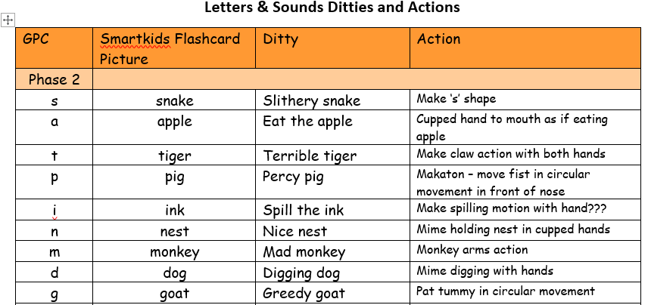
Actions to help learn!

Slide 25
Daily phonics Lesson
Revisit and review
Practise previously learned letter sounds
Teach
Teach new letter sound
Teach one or two tricky words
Practise
Practise blending and reading words with a new sound
Practise segmenting and spelling words with a new sound
Apply – really important!!
Read or write a caption or sentence using one or more tricky words and words
containing the new sound

Slide 26
What is the Year 1 Phonics Screening Check?
Every Year 1 child in the country will be taking the phonics screening check in June 25.
Aims to ensure that all children are making sufficient progress in phonics.
Identifies children who may need additional help.
Children read 40 words in two sections – real words and pseudo or ‘alien’ words.
Incorporated into normal school day.
Takes about 10 minutes.

Slide 27


What will children have to do?
Alien/nonsense words
Real words

Slide 28

Year 1 Phonics Screening Check

Slide 29

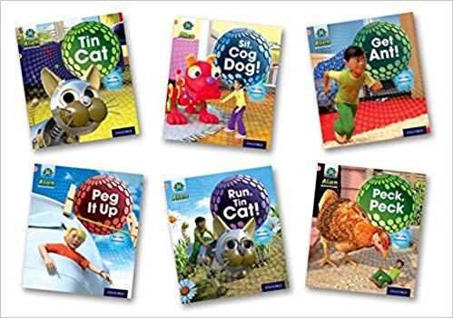

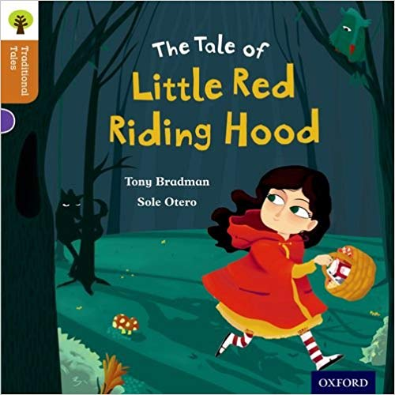
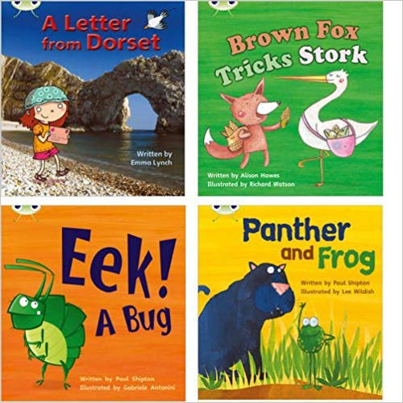


Guided Reading

Slide 30
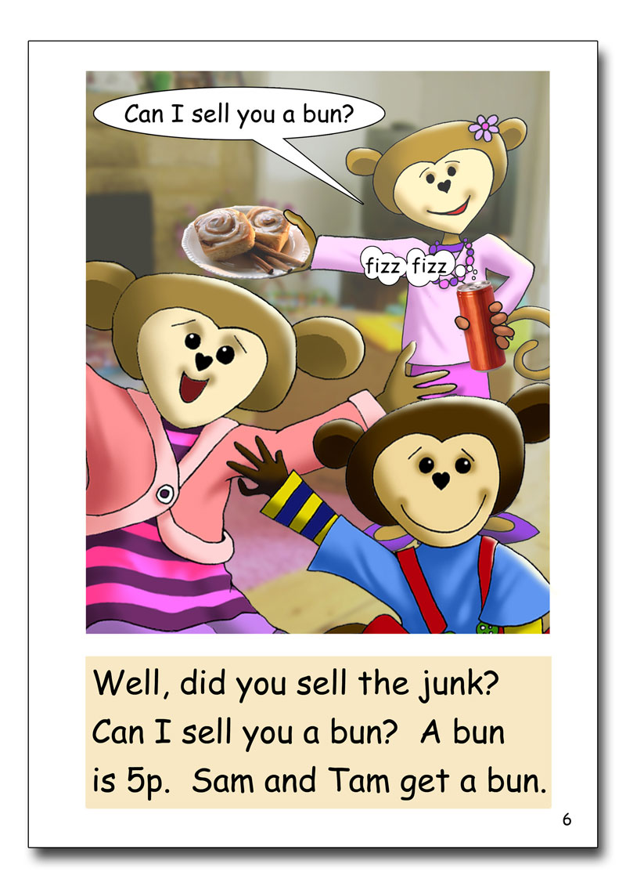
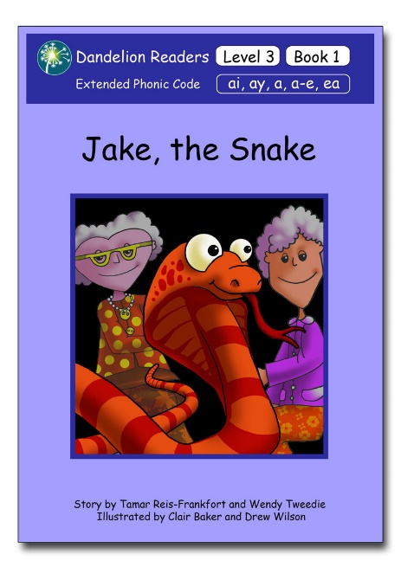
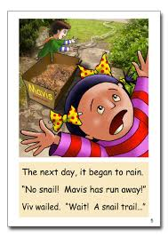
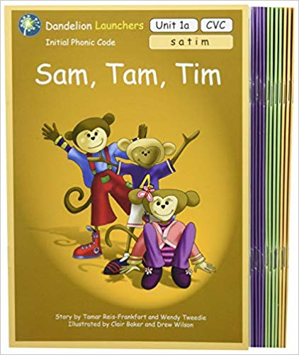
Reading scheme for Guided Reading
In EYFS and KS1 we use Dandelion readers.
These have been matched to follow our bespoke phonics programme
Each week children will read books that match the phonics sounds they have been taught.
Guided reading happens 3-4 times a week
Each group reads with an adult every session
Sessions follow a 4 part sequence in EYFS and Year 1 and a 3 part sequence in year 2.

Slide 31

Day 1 – Modelling and decoding
1. Introduce new text
Teacher introduces the title of the book, fiction/non fiction
Q: What do you think the book might be about? Why?
T reads the book to groups, pointing at the words as they read – modelling expression, intonation, using punctuation.
2. Graphemes and tricky words
Go through the grapheme and tricky word post it notes that the children will come across in the story.
Look at the pages where these graphemes and tricky words appear. Get children to use ‘finding fingers’ to find the graphemes and tricky words.
3. Choral reading
Children read in turn one page at a time, the other children follow with their reading fingers.
4. Comprehension questions
Who, what, where
the

Slide 32
Day 2 – Decoding
1.Recap –
Who can remember the title of the book? Main characters? Setting?
2. Graphemes and tricky words
Go through the grapheme and tricky word post it notes that the children will come across in the story. Look at the pages where these graphemes and tricky words appear. Get children to use ‘finding fingers’ to find the graphemes and tricky words.
3.Choral reading.
Children read in turn one page at a time, the other children follow with their reading fingers.
4.Comprehension questions
What do you think this means?
How dodo you think…?
Why do you think..?

Slide 33
Day 3 – Fluency and text composition
1.Recap –
Who can remember the title of the book, main characters, setting.
2. Graphemes and tricky words
Go through the grapheme and tricky word post it notes that the children will come across in the story.
Look at the pages where these graphemes and tricky words appear. Get children to use ‘finding fingers’ to find the graphemes and tricky words.
3. Looking a key sentence from the text and building it.
Modelled by teacher first.
4. Independent reading
Children then read the text independently.
T to move around the table and listen to each child read.
5.Comprehension questions – language choice focus
Can you find a word in the text that means? Why do you think the author used that word?

Slide 34
Day 4 – Fluency, Pace and comprehension
1.Recap – Who can remember the title of the book, characters, settings, main events
2. Graphemes and tricky words
Go through the grapheme and tricky word post it notes that the children will come across in the story.
Look at the pages where these graphemes and tricky words appear. Get children to use ‘finding fingers’ to find the graphemes and tricky words.
3. Reading and building of key sentence
Children build the key sentence from the text.
4.. Independent reading
Children then read the text independently.
T to move around the table and listen to each child read.
5. Comprehension questions – comparing to other texts.
Does this story remind you of another story? How is it similar?

Slide 35
Home Readers

Slide 36

Reception and Year 1
Will have their readers changed twice a week.
Please write a comment in you child’s reading record.
Children should read their home reader 3 times at home.
Reading the same book 3 times allows for the following:
Read 1: Decoding
Children will segment and blend unknown words. Adults can model how to sound out unknown words. Discuss the meaning of unknown words.
Read 2. Fluency and pace
Children become more fluent in their reading and comprehend what they have read. Ask your child questions about the characters and story for comprehension.
Read 3: Comprehension and tone
Focus on adding expression in reading, retelling and asking inference questions. Inference questions allow children to think more deeply about a text and use clues from the book and draw on knowledge from their own experiences.

Slide 37
Year 2
Will change their readers once they have finished them
Children are reading longer texts that may take them more than 3 days to read.
Continue to listen to your children read part/chapter of their book each night.
Continue to ask questions to ensure children are understanding the story and new vocabulary they may come across.
Please write a comment in your child’s yellow reading record.

Slide 38

Thank you for your ongoing support

