Slide 1
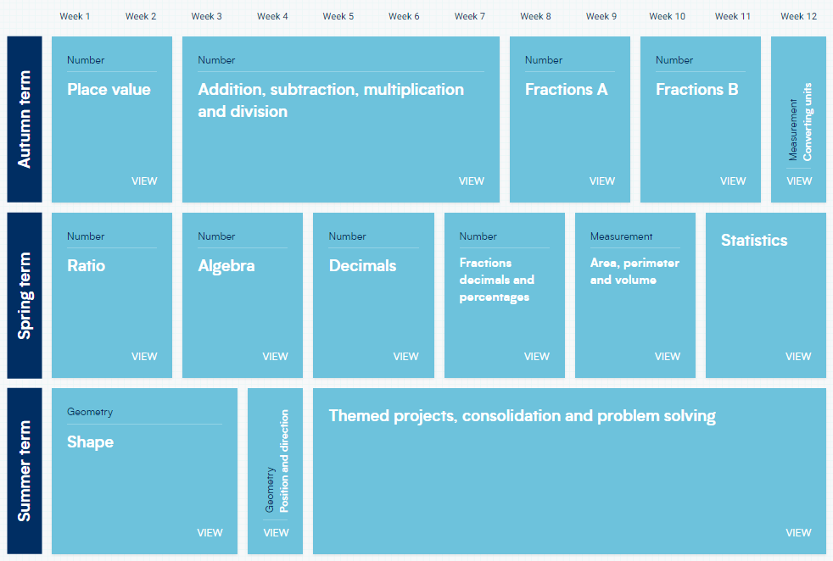
Year 6 – Yearly Overview
(New Scheme of learning)

