Slide 1
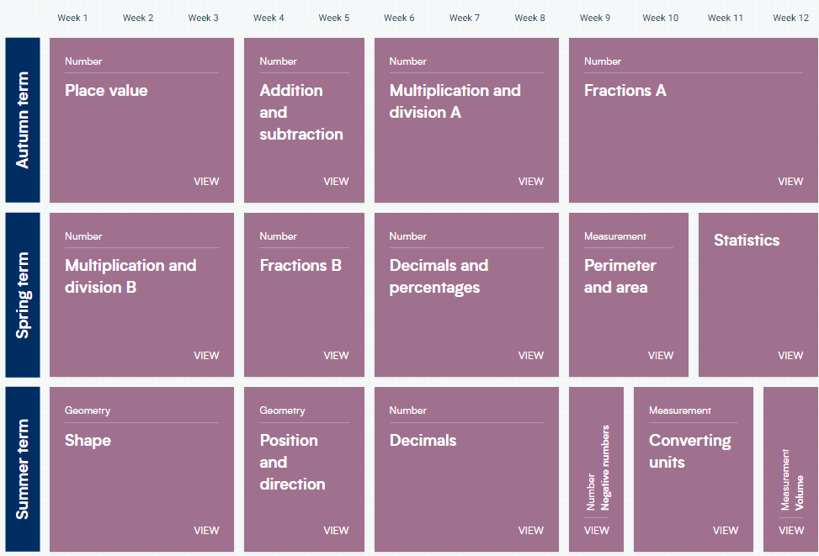
Year 5 – Yearly Overview
(New scheme of learning)

