Slide 1
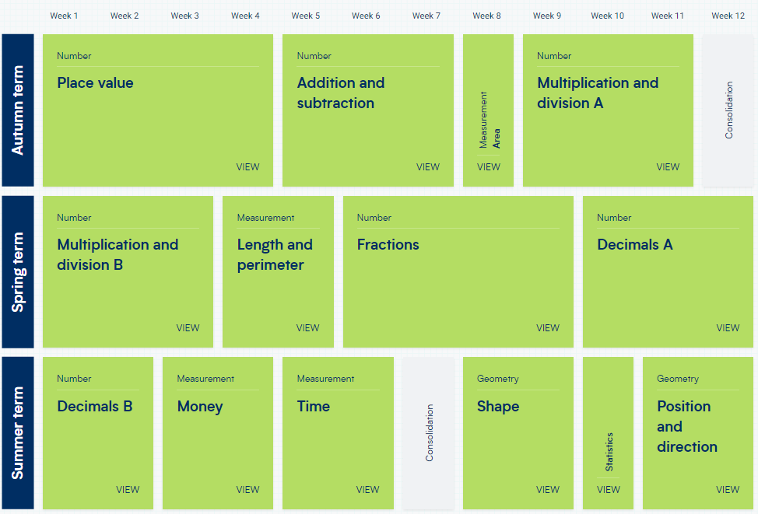
Year 4 – Yearly Overview
(New scheme of learning)

