Slide 1
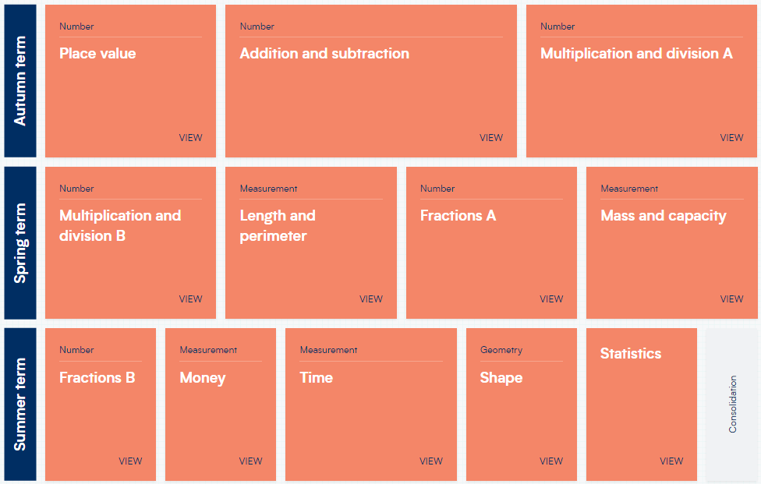
Year 3 – Yearly Overview
(New scheme of learning)

