Slide 1
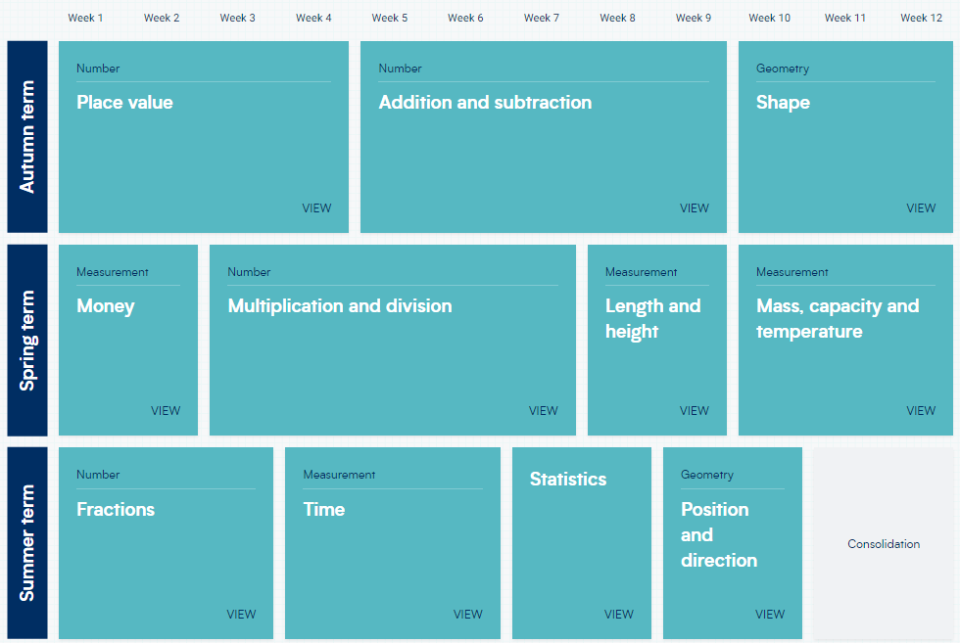
Year 2 – Yearly Overview
(new scheme)

