Slide 1
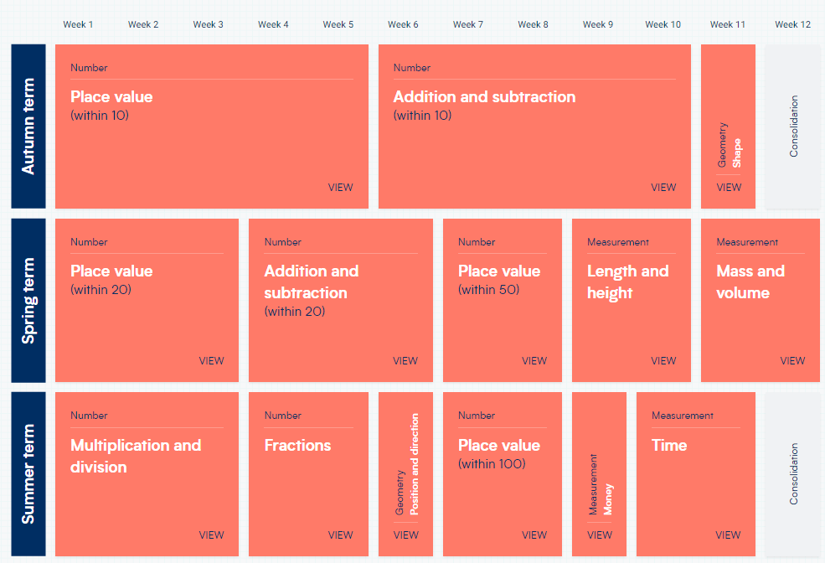
Year 1 – Yearly Overview (new scheme of learning)

